Slide 1
Cocktail Hour
6:30 P.M.

Slide 2
CARIBBEAN CRUSH

Slide 3
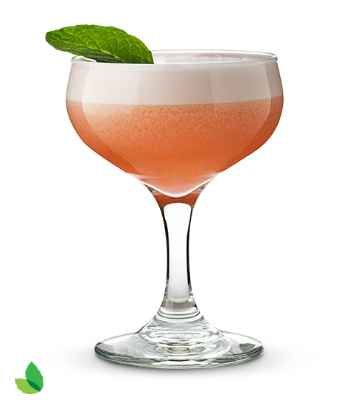

Slide 4
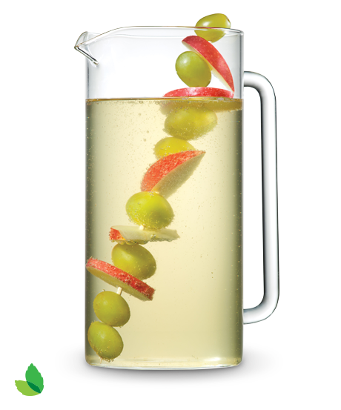

Slide 11
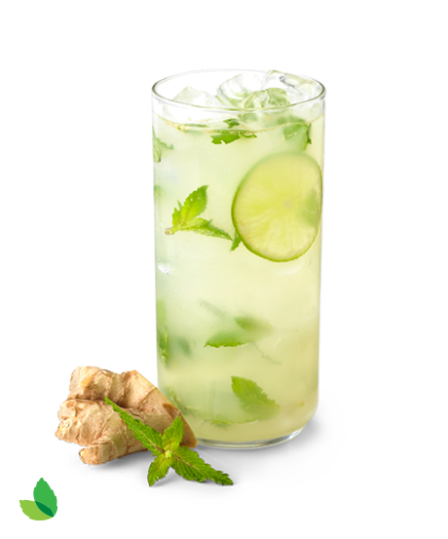

Slide 245
CARIBBEAN CRUSH

